Slide 1
EDUC2323 Computer Programming as a Tool for Learning
Syntonicity

Slide 2
Syntonic Learning
May be difficult to understand at first
Introduced by Seymour Papert in Mindstorms
Borrowed from Sigmund Freud’s idea of “ego syntonic”
When a person is “ego syntonic” they are in harmony with their fundamental ideas and beliefs
The root of the word syntonic basically means “in harmony”

Slide 3
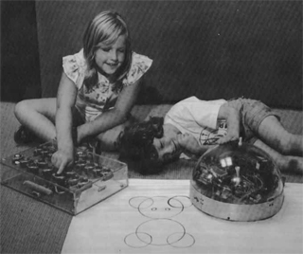
Logo Turtle
“The Turtle circle incident illustrates syntonic learning. This term is borrowed from clinical psychology and can be contrasted to the dissociated learning already discussed. Sometimes the term is used with qualifiers that refer to kinds of syntonicity. For example, the Turtle circle is body syntonic in that the circle is firmly related to children's sense and knowledge about their own bodies. Or it is ego syntonic in that it is coherent with children's sense of themselves as people with intentions, goals, desires, likes, and dislikes. A child who draws a Turtle circle wants to draw the circle; doing it produces pride and excitement.”

Slide 4
Syntonicity and Constructivism
“The zone of proximal development defines functions that have not matured yet, but are in a process of maturing, that will mature tomorrow, that are currently in an embryonic state; these functions could be called the buds of development, the flowers of development, rather than the fruits of development, that is, what is only just maturing” (Vygotsky, 1978).

Slide 5
Finding the Sweet Spot
If we create a learning experience that is too hard to work with, too hard to understand then the learner is likely to give up in frustration
If the task it too easy or too boring then the learner is likely to get bored and give up
Get the level of the task and the design of the task right it will become a beneficial learning experience
Syntonicity is one way of approaching system / instructional design such that the user / learner engages with the content in a more meaningful fashion.

Slide 6
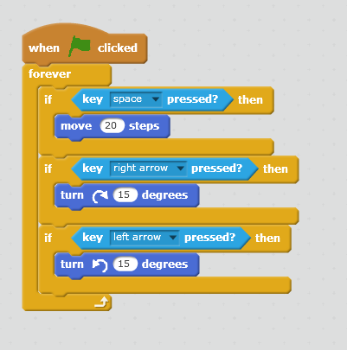
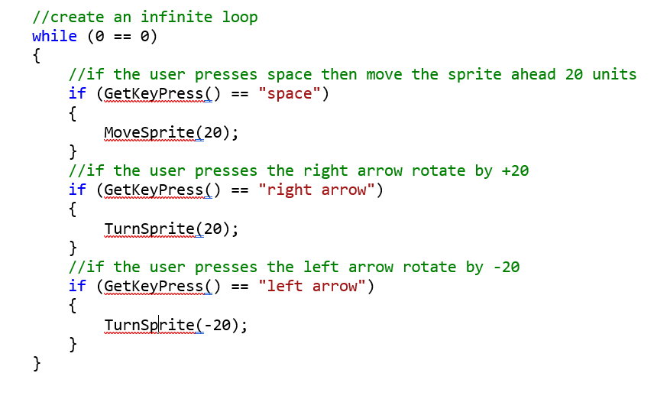
A form of Metaphor
Scratch as an example…
Syntonic learning runs a bit deeper than a metaphor in that it relates to some personal aspect of the learner

Slide 7
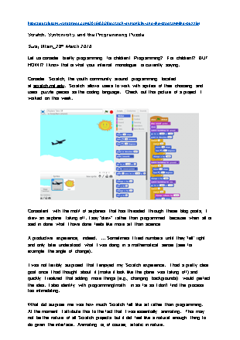
Take a Break
Take a look at the blog Post by Uttam (2016) linked on the module web site
What other types of syntonicity can you identify?
According to the blog author, how does Scratch extend or challenge the ideas of syntonicity that were associated by the older educational programming language Logo?

Slide 8
Types of Syntonicity
Computers and programming can be very abstract and mathematical
Doing something in the “real world” that we do in the computer helps engagement
  Body – physical self
  Ego – experience and feelings, relevant to self
  Cultural – values, social, cultural

Slide 9
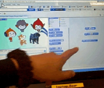

Body Syntonicity in Scratch
Case studies of Year 6 pupils using Scratch in 3 primary schools by Julia Briggs, Primary Education Technology Advisor, Somerset County Council.
“A pair of girls discovered ways to move and turn their character around the screen. Their enjoyment was clear and also their willingness to ‘have a go’ to see what might happen.”
“A pair of boys became fascinated by the movements they caused, ‘He’s circling, he’s going sideways because he’s a crab.’”
“Papert’s (1984) description of the turtle in logo programming, as being body syntonic, was echoed by the children who explored the use of programming blocks to create movements for sprites.”
“[… The] pair of girls giggled as their actions caused the character to turn or move off the stage. [The] pair of boys was proud of their crab which moved sideways round a circle.” (p9)

Slide 10
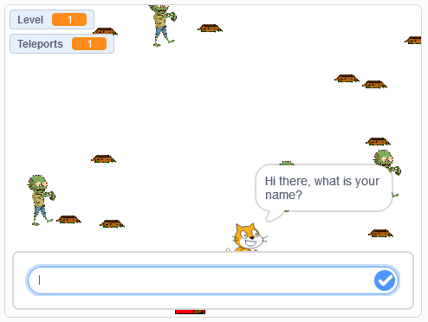
So What?
Questions related to Zombie Island…

Slide 11
Who is it aimed at?
The target group and age range are never specified for this sample program, but at what point does the program as it stands start to become inappropriate?
At what age do Zombies have some sort of resonance with children?
Might a sport metaphor be better e.g. running or football?
It assumes a certain level of “geekyness”

Slide 12
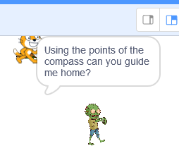
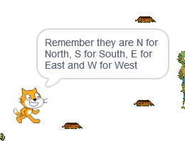
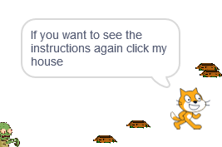
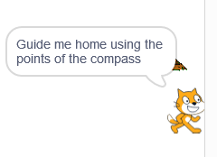
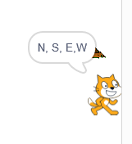
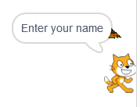
Is the Language Appropriate?
Or…

Slide 13
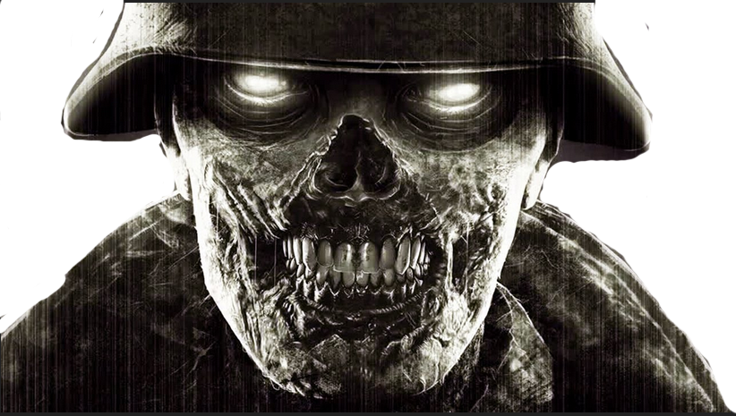
Finally, what if we changed the graphics?
Like so…

